Slide 1
Using Data Analysis to determine the most popular songs of 2019
Spotify Analysis by Addison Brown, Ashley Cleveland, and Jessica Jordan

Slide 2
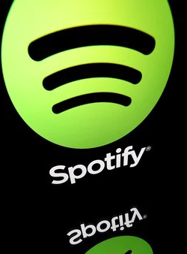
What’s the vibe?
With this project, we explore one of the most popular music streaming platforms, Spotify. We analyzed data around music popularity, artist popularity, and the top streaming locations around the world.

Slide 3


Motivation
Our goal was to interpret data from the Data set (2018) and in real-time from the Spotify API to understand the following:.
What IS the most popular Genre Worldwide? Was it really a Hot Girl Summer...
What factors determine popularity? Is it a bop or is it a vibe...
How does product growth affect artist, user, and market expansion? Growth always in all ways...
Notes:
Genre was a challenge with our data set-- it kept breaking and even though there was a clear column we spent several days segmenting our data based on genre and when we did, the data was subjective based on individual assumptions.
Even when we called Genre as an API, that didn't work and we ended up with popular artists being innovators of unknown “elusive genres” but popularity being more identifiable based on other factors.
The factors that determined popularity were consistently within the data set and API call
KEY (major or minor scale around which a piece of music revolves)
MODE (This example is entirely subjective, but I find the more sharps and fewer flats used in a mode, the more uplifting and happy the vibe feels. Concurrently, using more flats, the darker and more sinister the sound becomes. I feel this way because certain sounds, chords, and Modes are associated with certain emotions. For example, Lydian and Ionian Modes are used in happy and spiritually uplifting music. Mixolydian and Dorian Modes are often used in blues and gospel music. The Aeolian (minor) Mode is defined as melancholy and sad while Phrygian and Locrian Modes are the go-to Modes for scary, dramatic, and otherworldly sounds.)
DANCEABILITY (Danceability: How danceable a song based on musical elements including tempo, rhythm stability, beat strength, and overall regularity) Drake Drake Drake

Slide 4
How many genres of music are needed to impact the world?

Slide 5

Just one.
“The Death of Genre
is overdue.”
~THE NEW YORKER

Slide 6
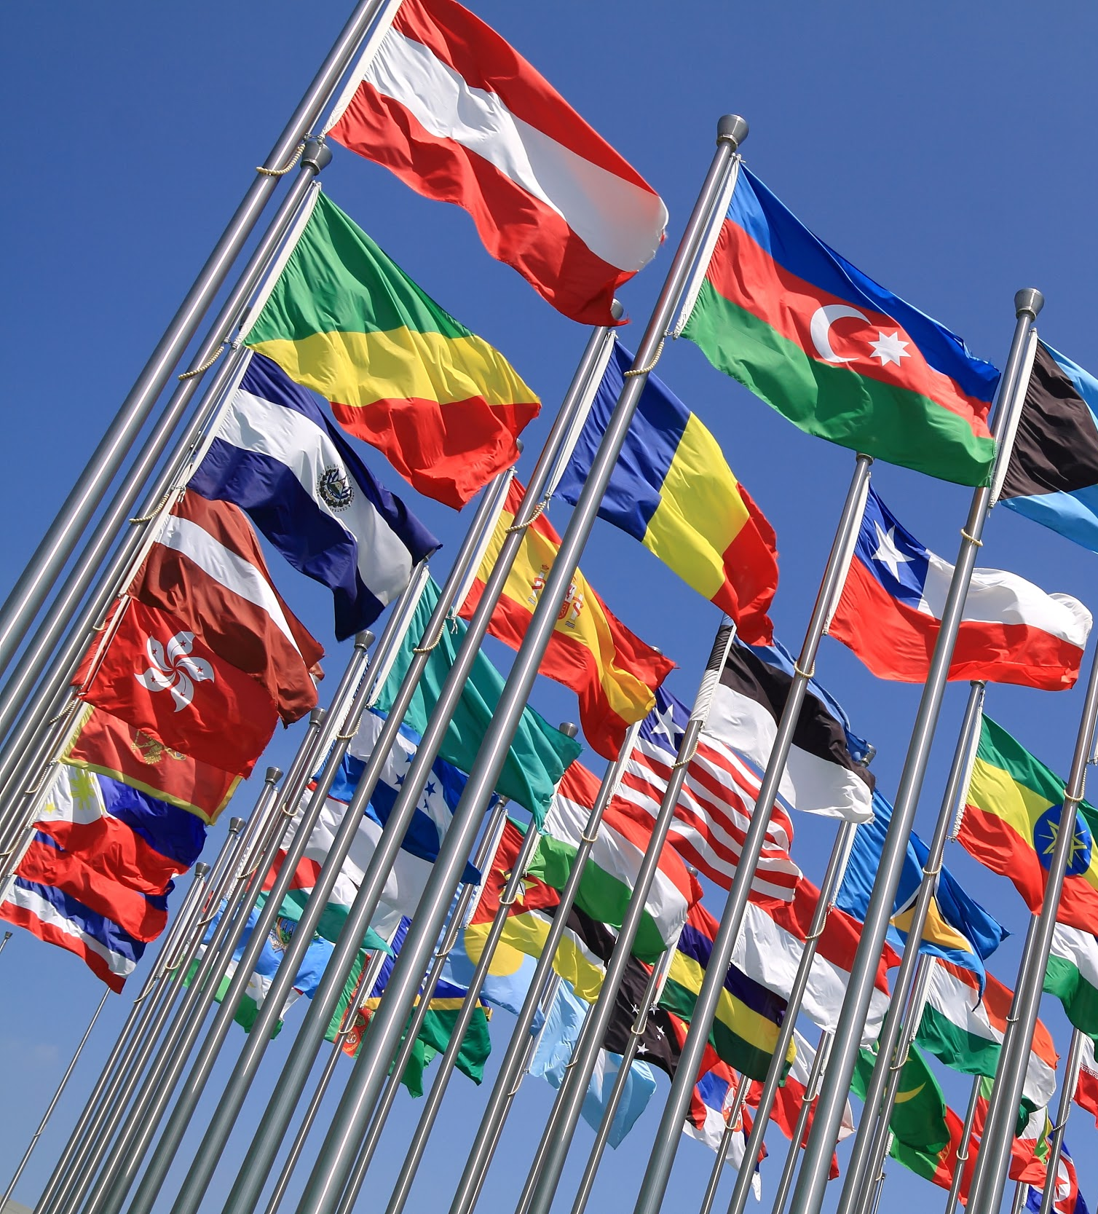
During the incubation period, Spotify wanted to create a genreless musical experience to expose it’s now 217 MILLION SUBSCRIBERS to music with different tempos and drum sequences from all around the world.
Notes:
Moving between genre “is not something we normally see from programmed offerings, so in the beginning, it did feel like there were some walls there,” Stein says. “Now it feels natural.” - John Stein, Co-Creator of Spotify’s Genre-Less Pollen Playlist

Slide 7

#What is the most popular genre based on the data set?
 | Genre | No. of Tracks
0 | Pop | 9,052
1 | Rock | 5,915
2 | Rap | 5,887
3 | Hip-Hop | 4,891
4 | Dance | 4,418
Notes:
We used our data set via kagle to find the above values based out of 288K tracks

Slide 8

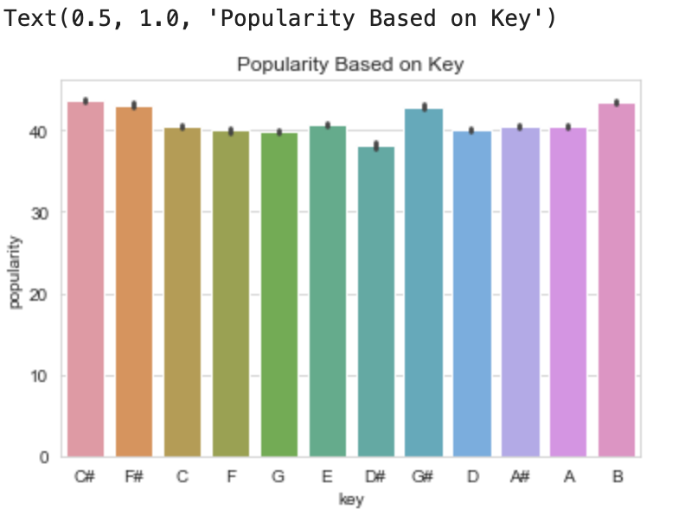

#What top 3 factors determine popularity?
Notes:
Using a dataset of 228,000 Spotify Tracks, we were able to predict popularity
(greater than 57% popularity) using audio-based metrics such as key, mode, and danceability
*We’ll discuss these findings in our ability to predict music findings in the next few slides

Slide 9

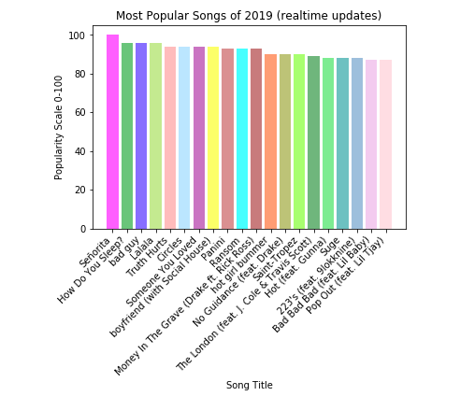
#What was the most popular song of Summer 2019?
Notes:
The popularity of the track. The value will be between 0, for least popular, and 100 for most popular. The popularity of a track is a value between 0 and 100, with 100 being the most popular. Popularity is based mainly on the total number of playbacks.

Slide 10
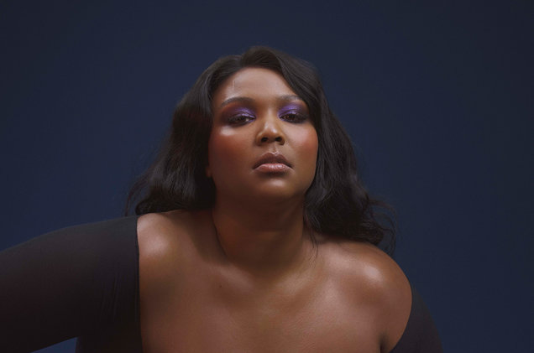
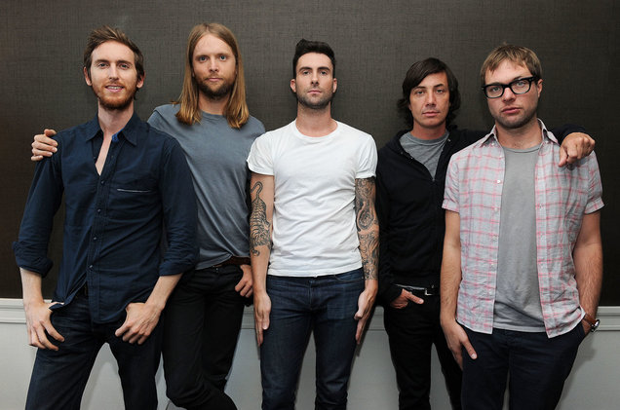
#Who are the most popular artists of 2019 to date?
Artists | Popularity
Shawn Mendes | 100
Lizzo | 96
Maroon 5 | 95
Notes:
a. Female - Lizzo 95
b. Male - Shawn Mendes 100
c. Group - Y2K 96

Slide 11

#Where are the highest concentrations of listeners worldwide?
Notes:
MEXICO CITY, MEXICO IS THE NUMBER 1 MARKET FOR MANY ARTISTS ON SPOTIFY
Mexico City has evolved in a few short years from being Spotify’s first-ever Latin American market, in 2013, to our largest listener base worldwide today.

Slide 12
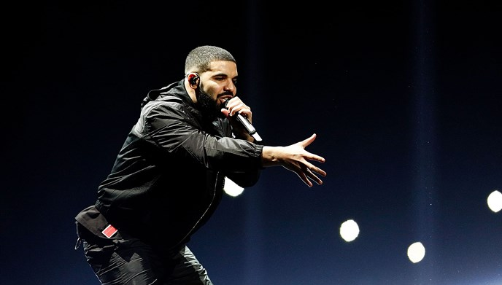
#What predictions can we make based on music popularity from calling the API the given Data Set?
Notes:
The closer the danceability index is to 1 the more likely it will be a “popular” song.
G Major and C Major rule all other keys
G Major accounted for 10.7 percent of songs, while C Major made up a slightly fewer mass with 10.2 percent.
Artists who develop their own genre-less style or create music that is a combination of the most popular (dance, hip hop, pop) will find success with this new generation of digital consumers
Drake -- Highest streamed artists of all time with over over 8.2 billion streams in 2018, over 50% of his top 100 songs are in G Major via https://inwhatkey.com/artist/134-drake

Slide 13

Data Clean Up
& Exploration
Notes:
Data Exploration:
Review the characteristics of our dataset making sure the size was large enough and the data was accurate
Gain access the Spotify API and it’s available endpoints to have the most current data (real-time)

Slide 14
Sources of Data
Exploration & Clean Up SpotifyFeatures.csv
Unexpected Insights Spotipy is a thin client library for the Spotify Web API
Challenges

Slide 15
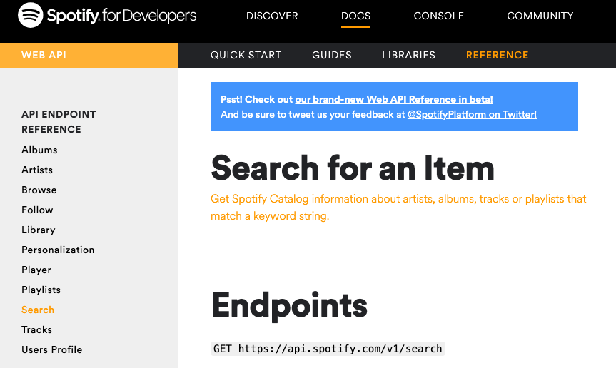

Slide 16
The Process
Find Unique Values
Group the Data
Sort the Data
Making the Right API Call
Plotting the Data for Analysis
Notes:
To Clean the data we used python to:
Read our data set
Read the CSV file
Make call to API
Create DataFrames
Remove duplicate values
Grouping by genres
Sort the data for the highest values
Plotting the data using bar, distribution, and pie charts

Slide 17
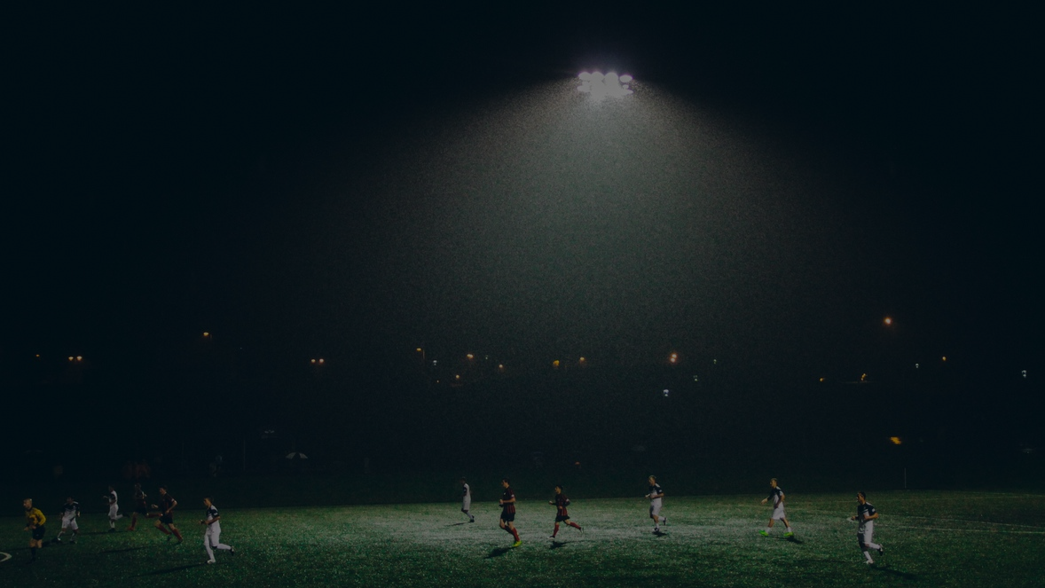
Data Analysis
Our Goal was to use previously retrieved and real time data along to gain insights from the popularity feature such as most popular tracks and most popular artists by analyzing and visualizing the data using Python libraries Pandas, Spotipy, Spotify API, Numpy and Matplotlib.

Slide 18
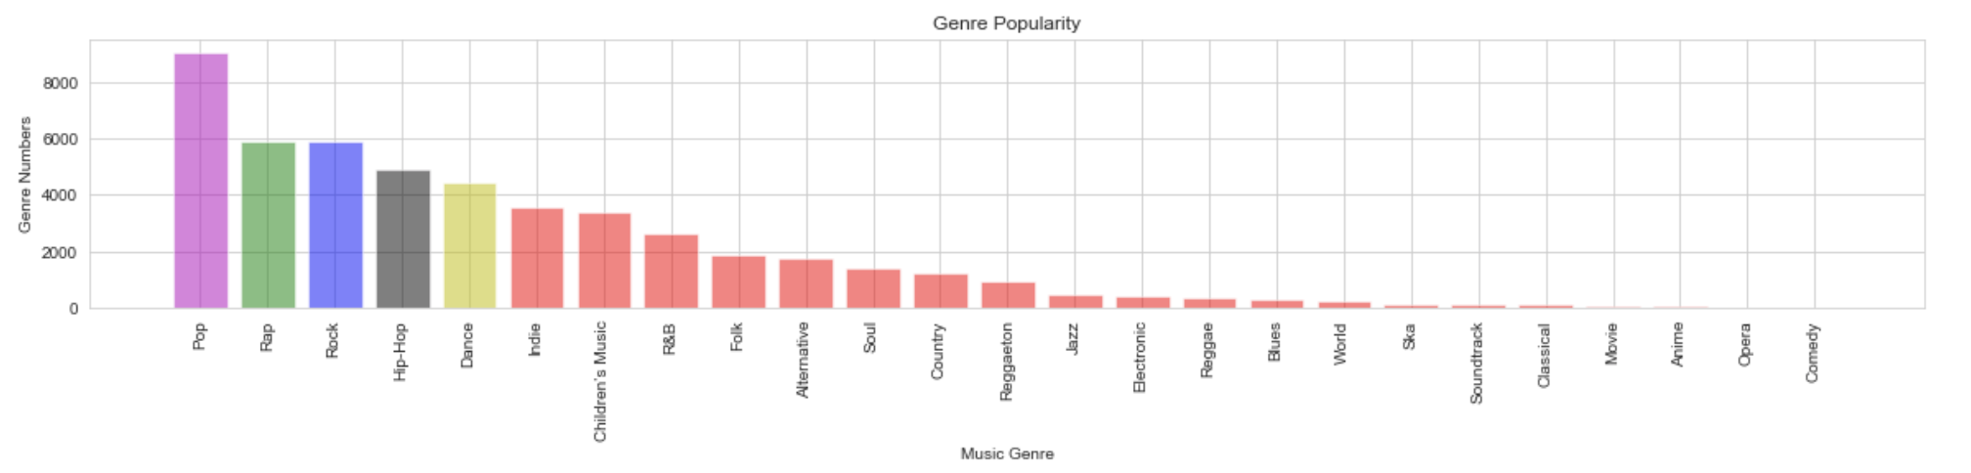
Notes:
This is a bar chart stating the 27 different genres that Spotify considers internationally.
The top 5 international genres are colored coded.
Obviously the top genre of Spotify is Pop.
Even from the Pop genre to the Rap genre is tremendously different.
The remaining genres had a massive decrease in popularity.

Slide 19
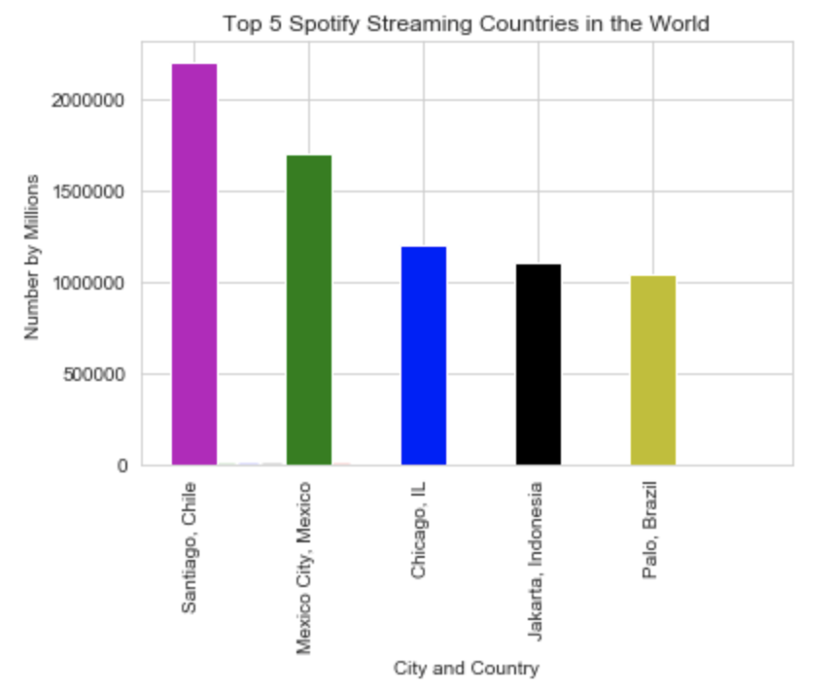
Notes:
Top 5 cities and countries that spotify streams in.

Slide 20
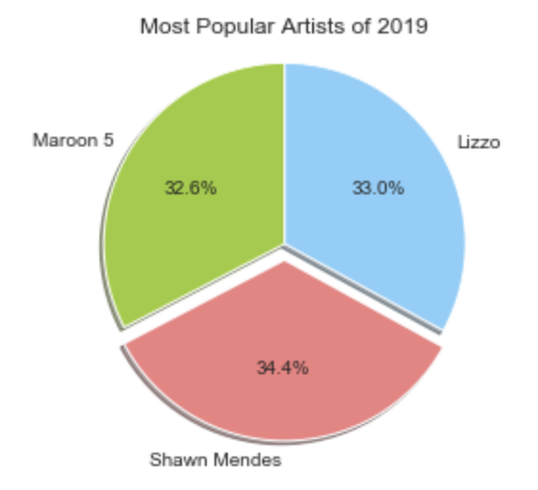
Notes:
This shows that the top 3 Spotify musicians also fall into the same genre category of Pop.
Maroon 5 - 95%
Shawn Mendes - 100%
Lizzo - 96%

Slide 21
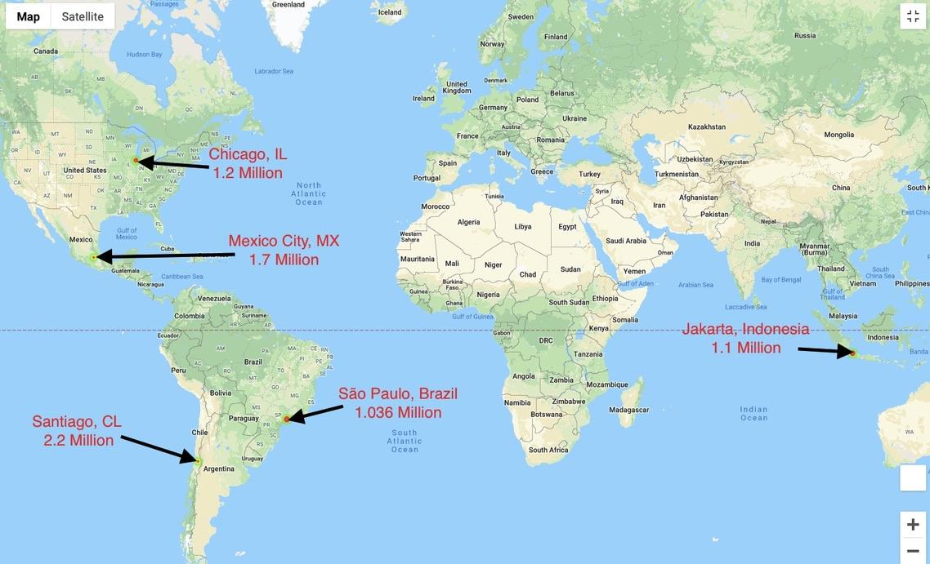
Highest Concentration of Listeners Worldwide

Slide 22
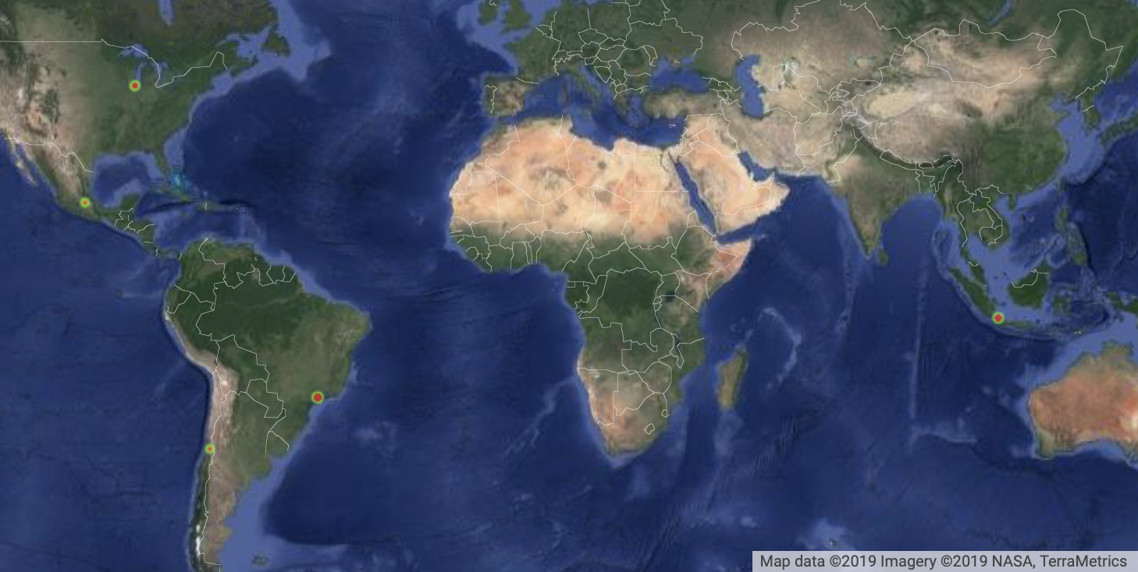

Slide 23

QUESTIONS?
Notes:
Post Mortem
Difficulties that arose, and how you dealt with them
API call took days
Genre columns
G key and uploading-- kicked out
Additional questions that came up, but which you didn't have time to answer: What would you research next, if you had two more weeks?
Determine the other factors that determine popularity and
Forecast how artists can be successful with incorporating these factors within their songwriting and production

Slide 24
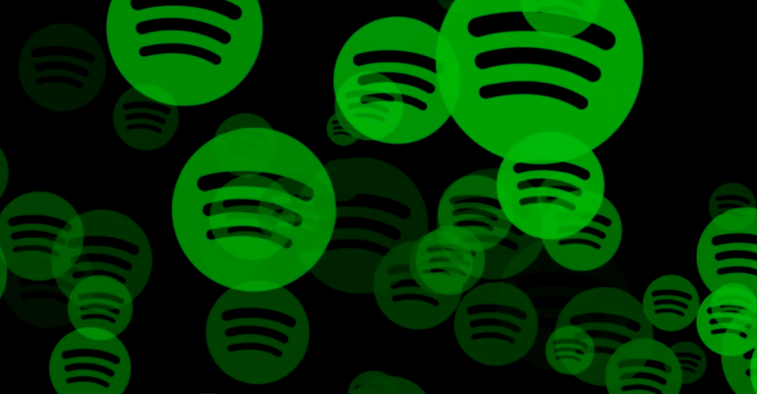
THANK YOU!

